Slide 1
Detection and removal of microplastic contamination in Kamloops municipal compost
Emma Trotta
Supervisors: Naowarat Cheeptham, Anusha Venkataraman

Slide 2

I would like to acknowledge that we are on the traditional and unseated territory of the Tk'emlúps te Secwépemc and I am grateful to be able to present and conduct my research on this land

Slide 3
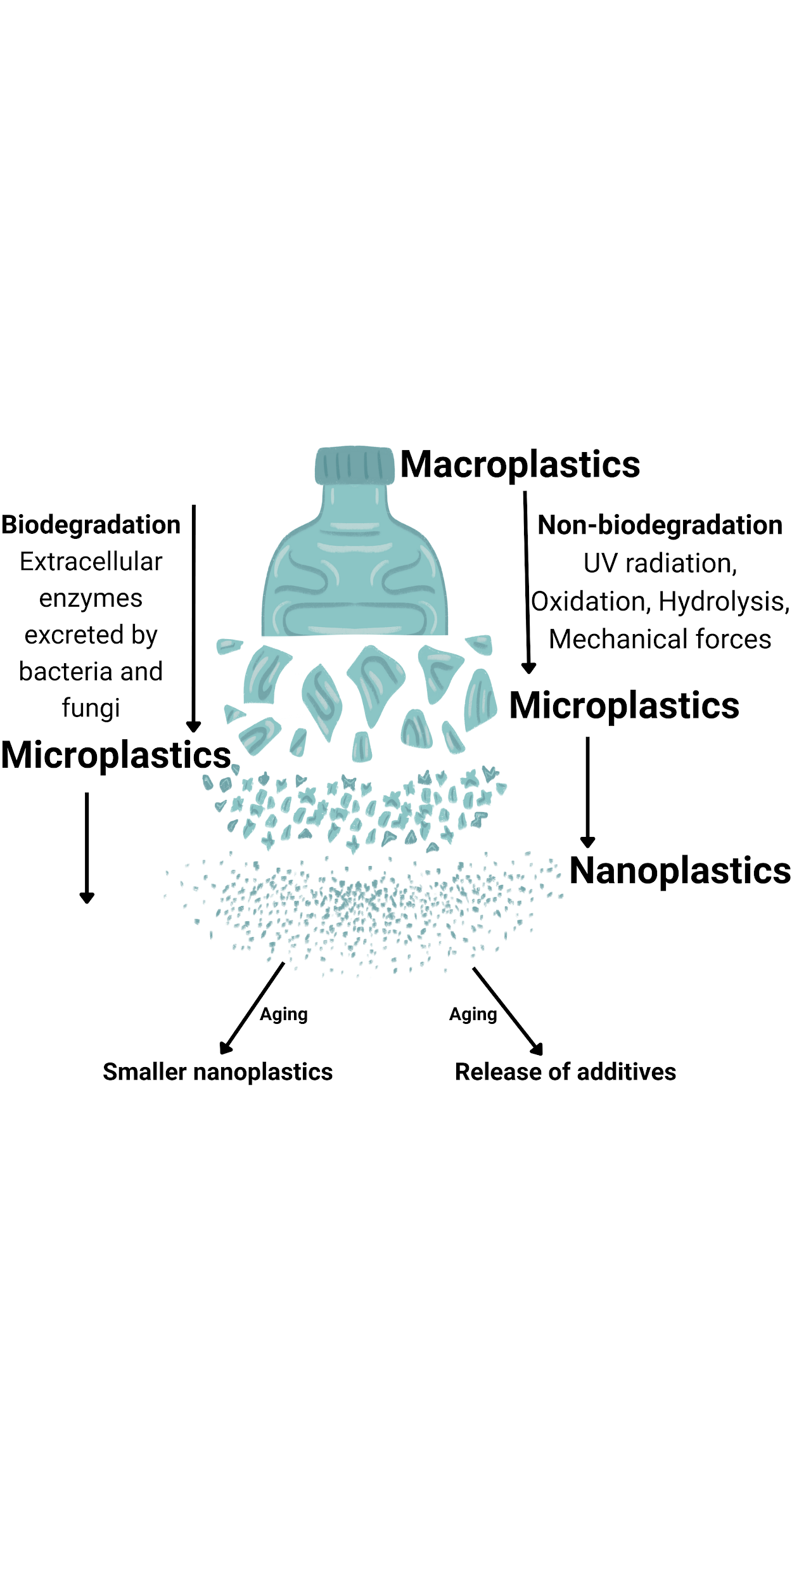
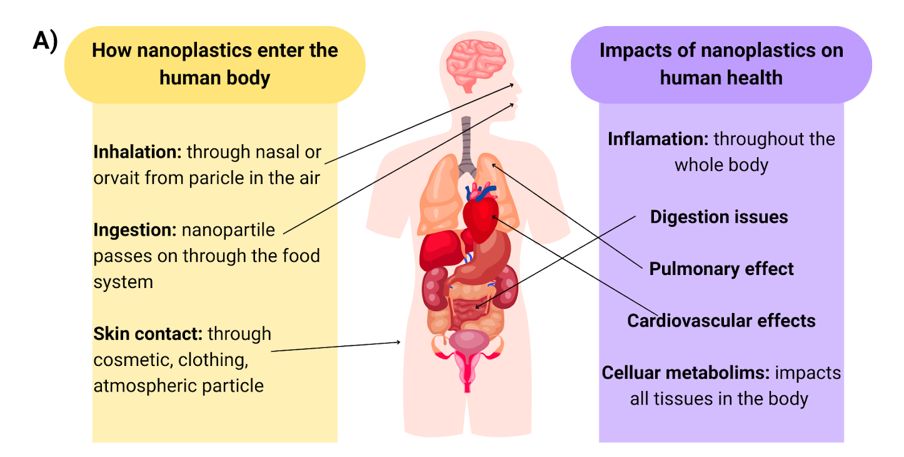
What are microplastics?
What are their impacts?
Pieces of plastics that are <5mm in size
Broken into smaller pieces due to natural processes
Limit plant nutrient uptake
Oxidative stress
Inflammation

Slide 4
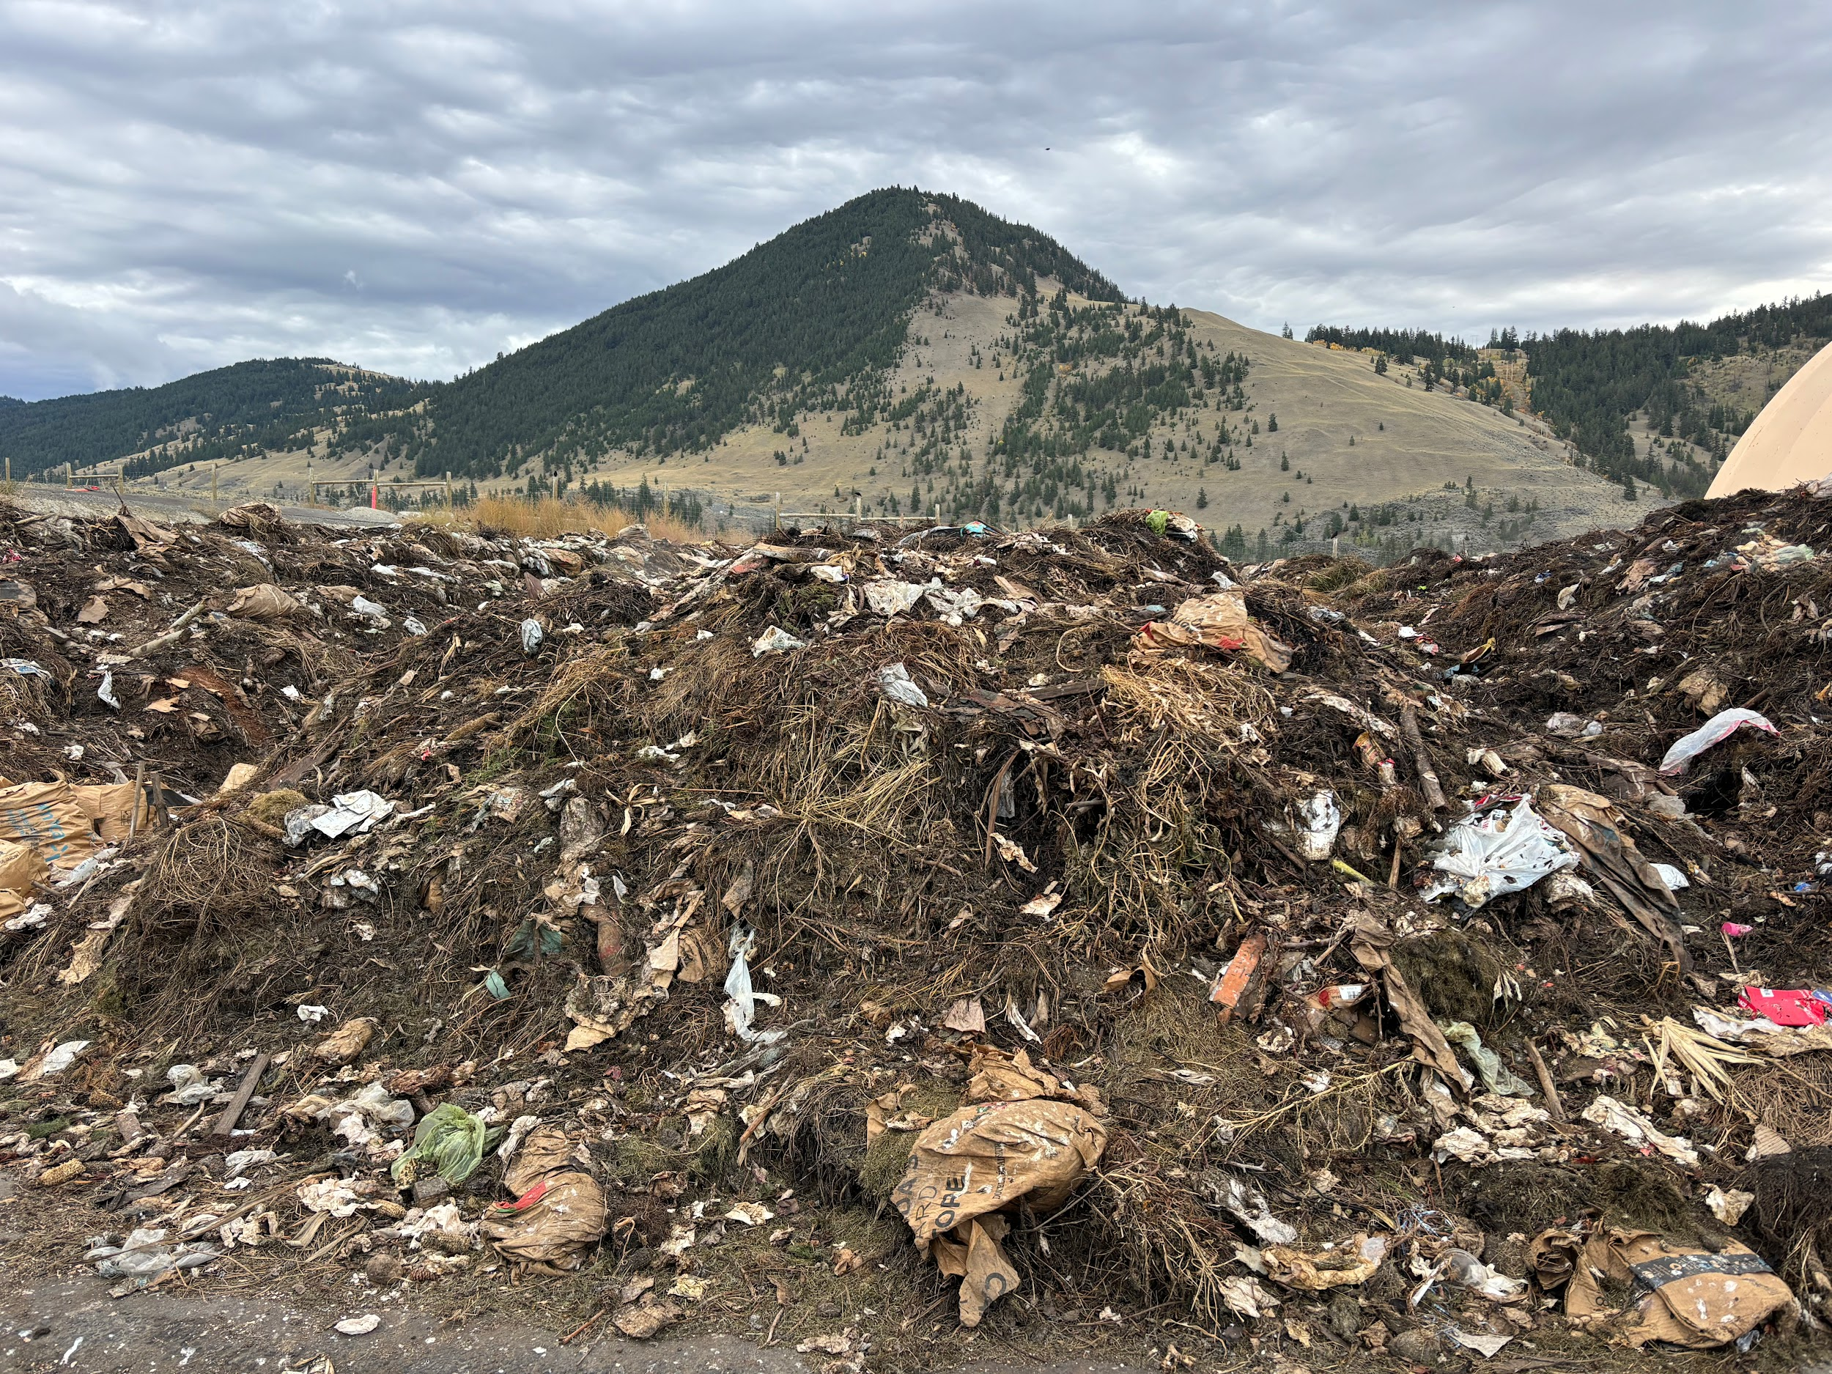
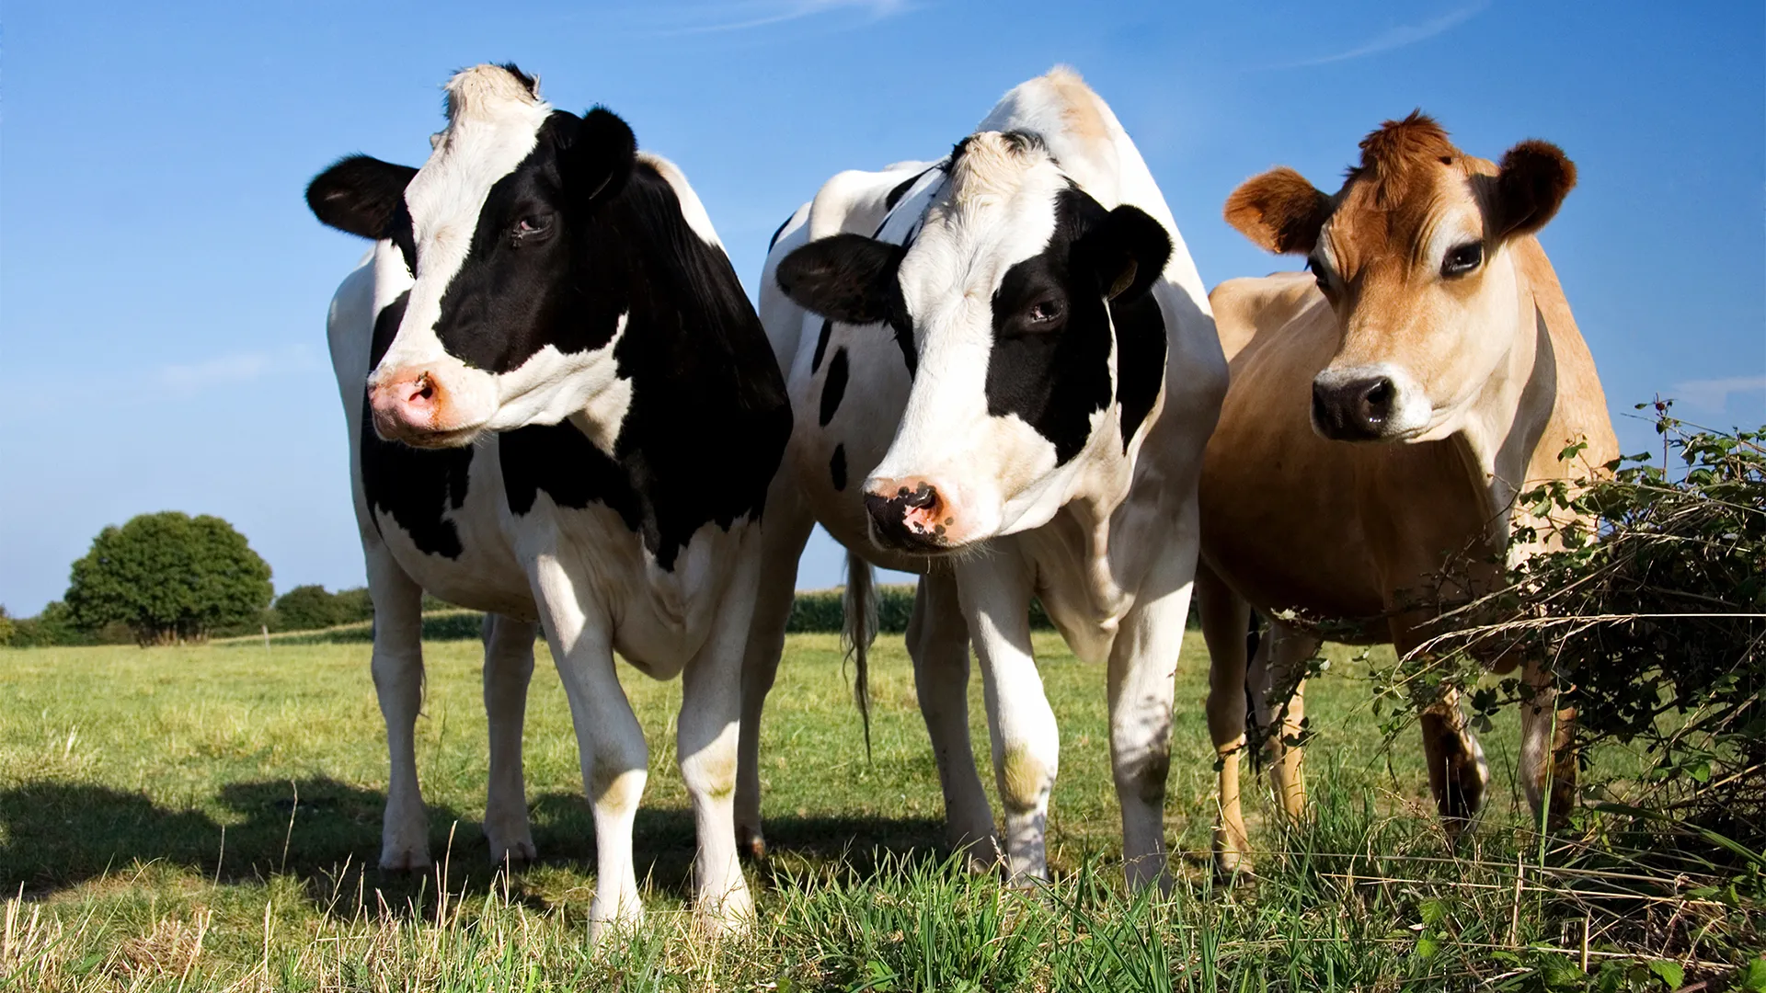
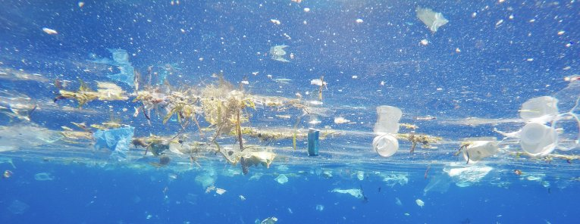
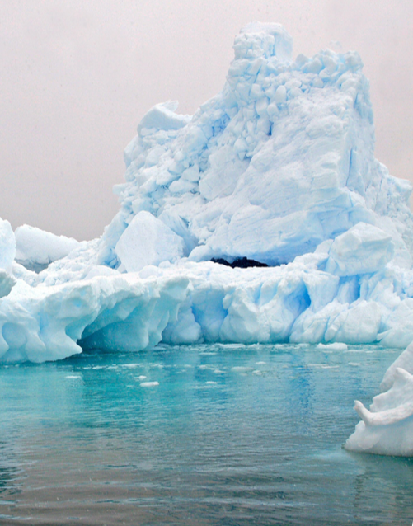

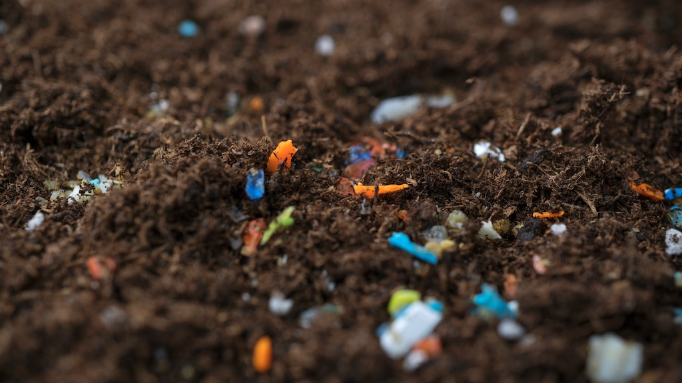
Where are they found?
Everywhere

Slide 5
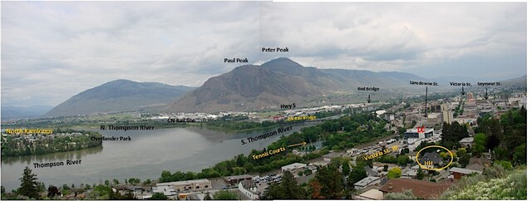
Kamloops Municipal Composting Program
Summer of 2023 Kamloops curbside pick-up program launched
Grassland Organics
Grassland Organics

Slide 6
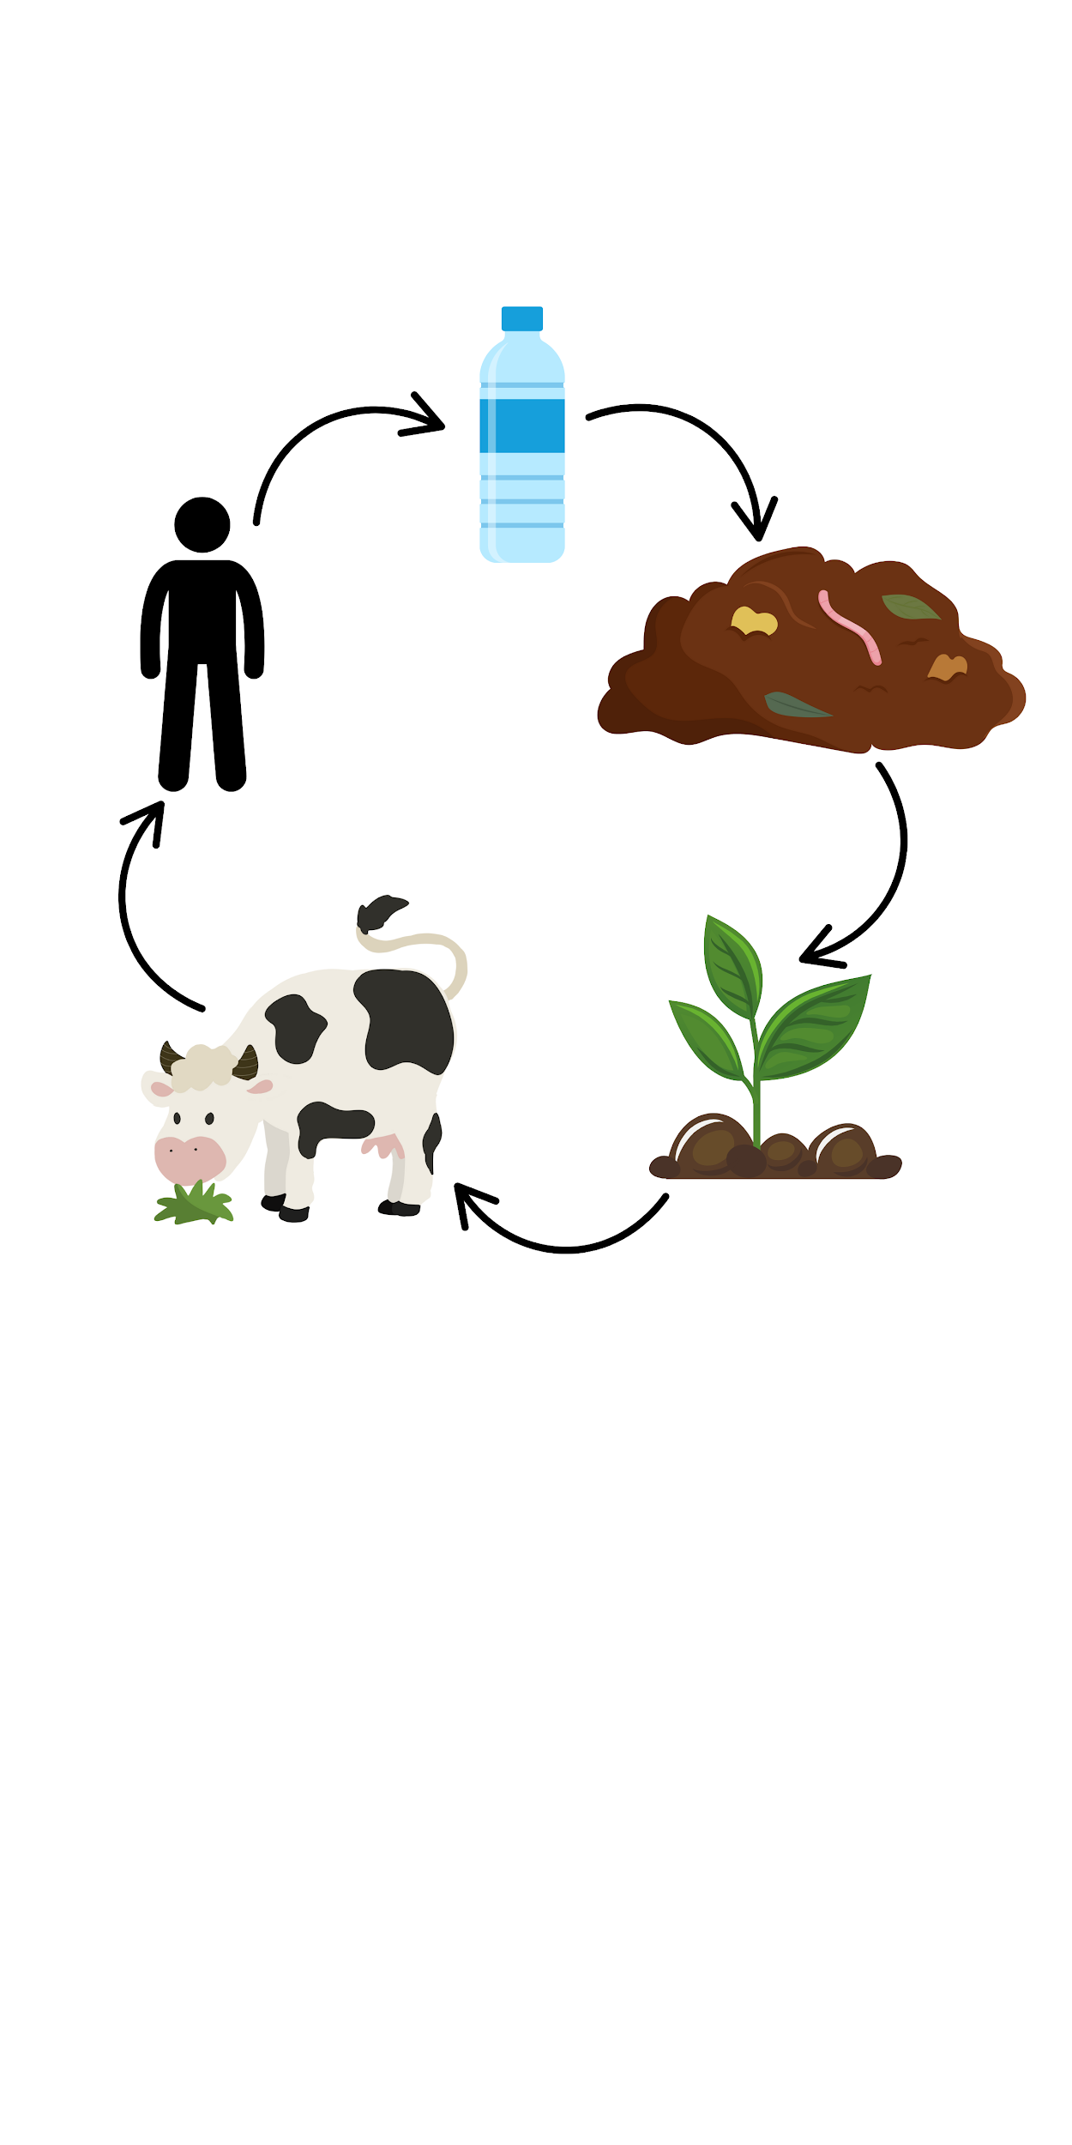
Why is composting important?
Many agricultural implication (fertilizers)
Reduced methane emissions
Natural recycling process
Compost impacts many ecological and biological system
MP leach into soil → plants → animals → humans ³
Can be contained/controlled system

Slide 7
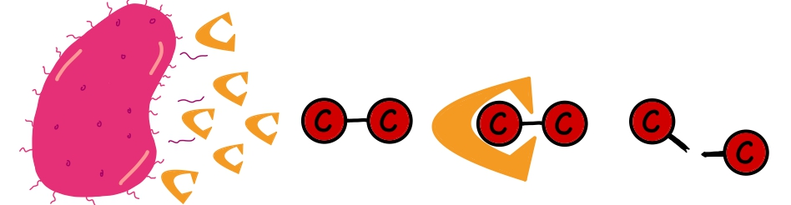
Plastics degrading bacteria
Some bacteria can bacteria degrade plastic
Produce extracellular enzymes that can break the strong molecular bonds holding plastic compounds together ⁶
Use plastic as an energy source
H₂O and CO₂ by-products

Slide 8
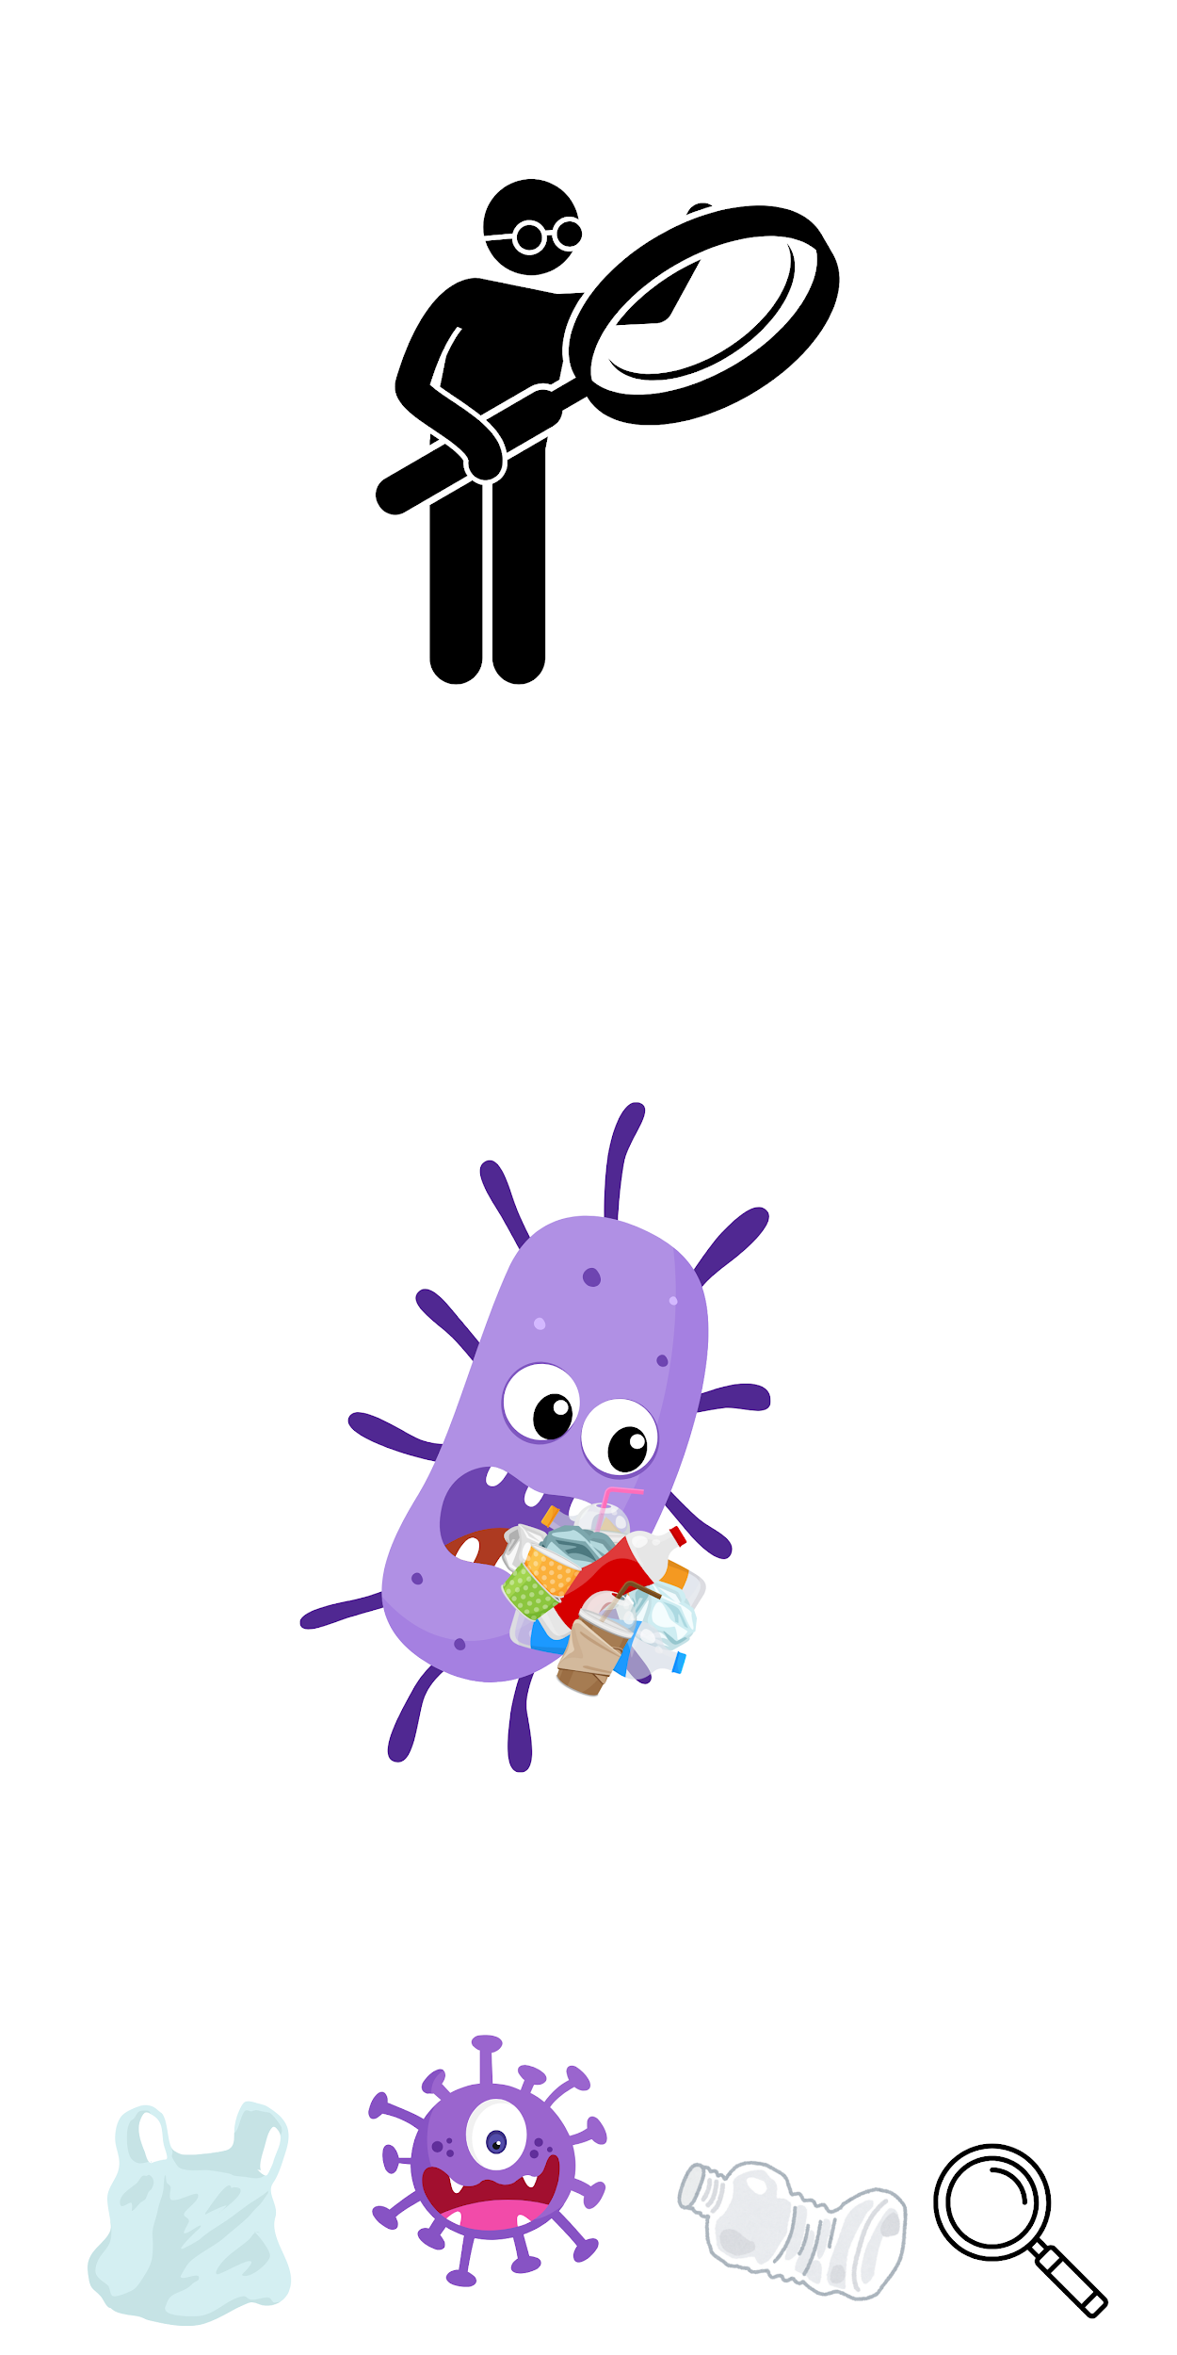
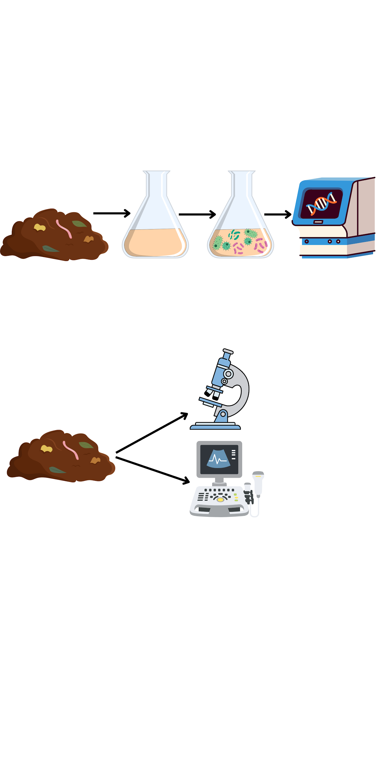
Project Goals
Identify in any bacteria already present in the compost that can degrade plastics
Detect microplastics in Kamloops compost

Slide 9
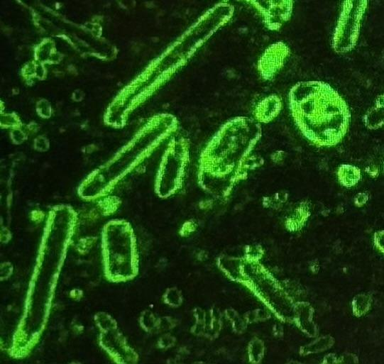
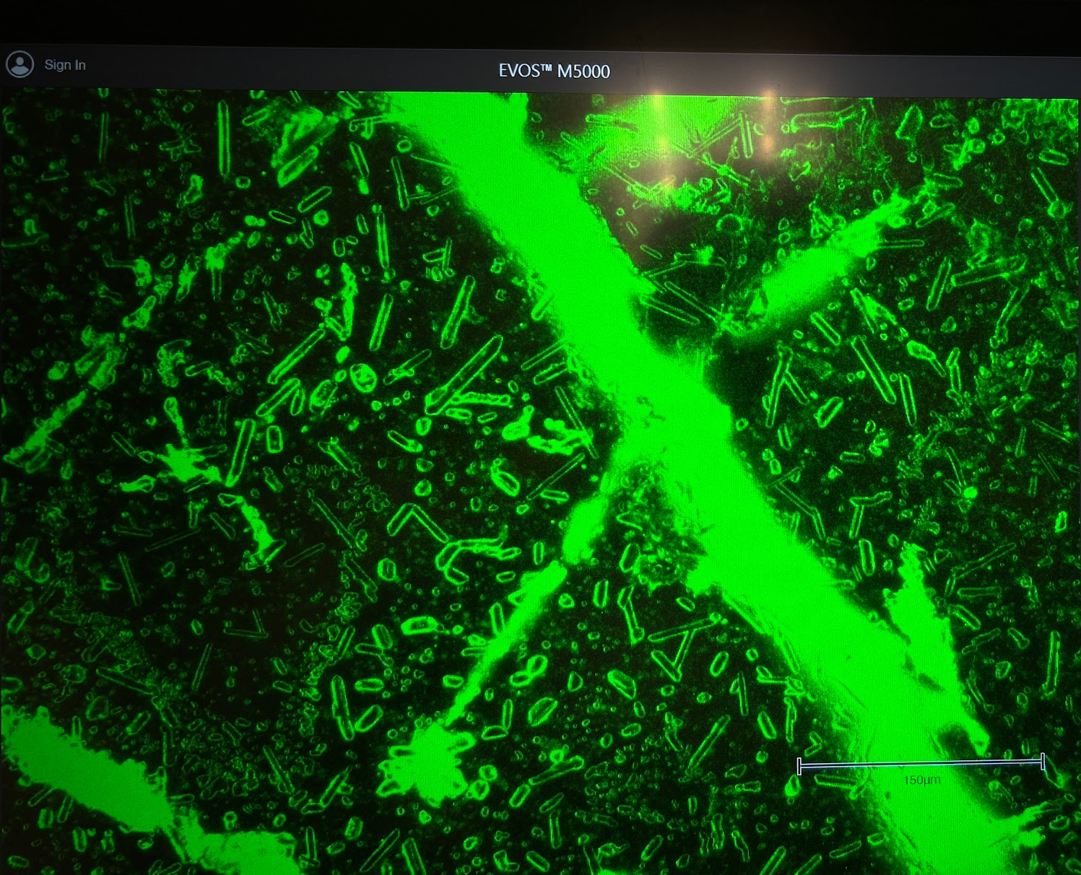
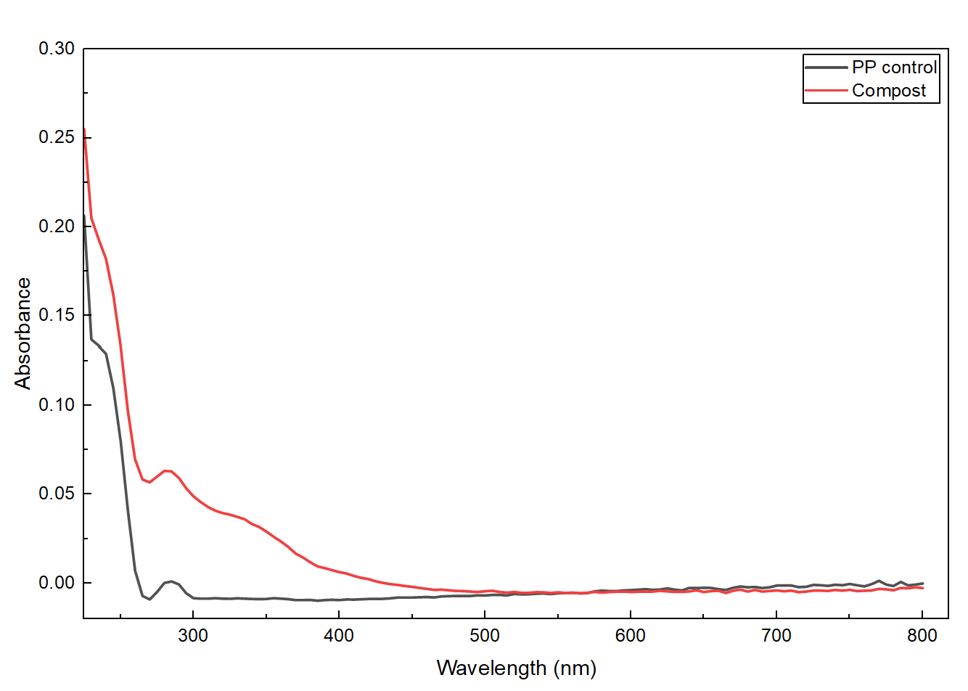
1. Detection of microplastics in compost
Microscopy and Spectroscopy techniques
Fluorescent microscopy
Visualize plastics under the microscope
Fluorescent outline and sharp shapes
UV-Vis spectroscopy
Wavelength and absorbance peaks
Match peaks of plastic to compost

Slide 10
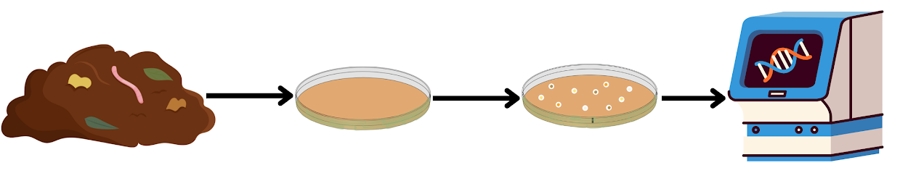
2. Microbial degradation experiments
Multiple collection times as the compost matures (Initial, 8 weeks, 4 months)
Grow on a double layered plate
enriched media with plastic on top
16S rRNA sequencing (solid compost/isolated cultures)

Slide 11
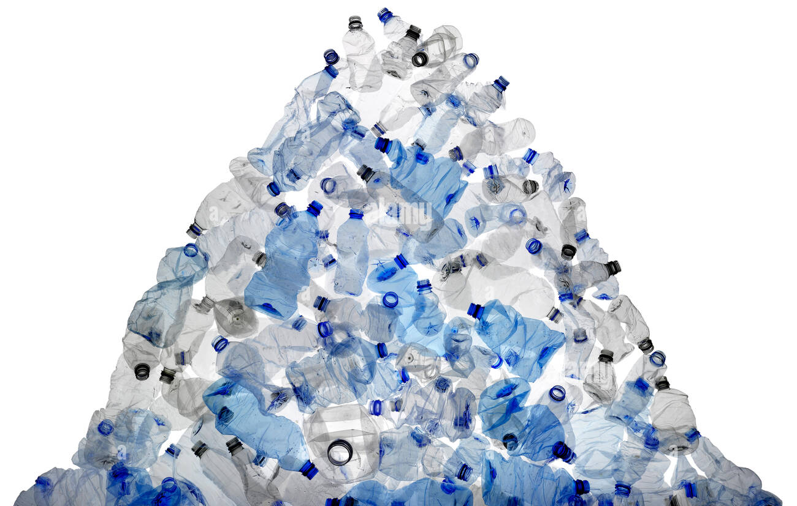
Plastic Crisis and Calls to Action
400 tons of plastics are still made every year ¹
Less than 10% get recycled ²
What we put into our compost impacts our own person health

Slide 12
References
[UN]. Beat Plastic Pollution. https://www.un.org/pl/node/71013#:~:text=Beat%20plastic%20pollution,cleaner%20and%20more%20sustainable%20future.
Horton AA, Walton A, Spurgeon DJ, Lahive E, Svendsen C. 2017. Microplastics in freshwater and terrestrial environments: Evaluating the current understanding to identify the knowledge gaps and future research priorities. Science of The Total Environment. 586(586):127–141. doi:https://doi.org/10.1016/j.scitotenv.2017.01.190.
Ingraffia R, Amato G, Iovino M, Rillig MC, Giambalvo D, Alfonso Salvatore Frenda. 2022. Polyester microplastic fibers in soil increase nitrogen loss via leaching and decrease plant biomass production and N uptake. Environmental Research Letters. 17(5):054012–054012. doi:https://doi.org/10.1088/1748-9326/ac652d.
Théogène Habumugisha, Zhang Z, Uwizewe C, Yan C, Jean Claude Ndayishimiye, Rehman A, Zhang X. 2024. Toxicological review of micro- and nano-plastics in aquatic environments: Risks to ecosystems, food web dynamics and human health. Ecotoxicology and environmental safety. 278:116426–116426. doi:https://doi.org/10.1016/j.ecoenv.2024.116426.
Yee MS-L, Hii L-W, Looi CK, Lim W-M, Wong S-F, Kok Y-Y, Tan B-K, Wong C-Y, Leong C-O. 2021. Impact of Microplastics and Nanoplastics on Human Health. Nanomaterials. 11(2):496. doi: 10.3390/nano11020496.
Cai Z, Li M, Zhu Z, Wang X, Huang Y, Li T, Gong H, Yan M. 2023. Biological Degradation of Plastics and Microplastics: A Recent Perspective on Associated Mechanisms and Influencing Factors. Microorganisms. 11(7):1661–1661. doi: 10.3390/microorganisms11071661.
Boakye GA, Trotta E, Ambagahawatta N, Venkataraman A, Cheeptham N, Papadopoulos C. 2025. Nanoscale plastic pollution: sources, identification and potential mitigation. Nanotechnology. 36(42):422001. doi:https://doi.org/10.1088/1361-6528/ae0c1b.

Slide 13




Thank you
Any Questions?

