Slide 1
Detection and Removal of Microplastics in Kamloops Compost
Emma Trotta
Supervisors: Naowarat Cheeptham, Anusha Venkataraman

Slide 2
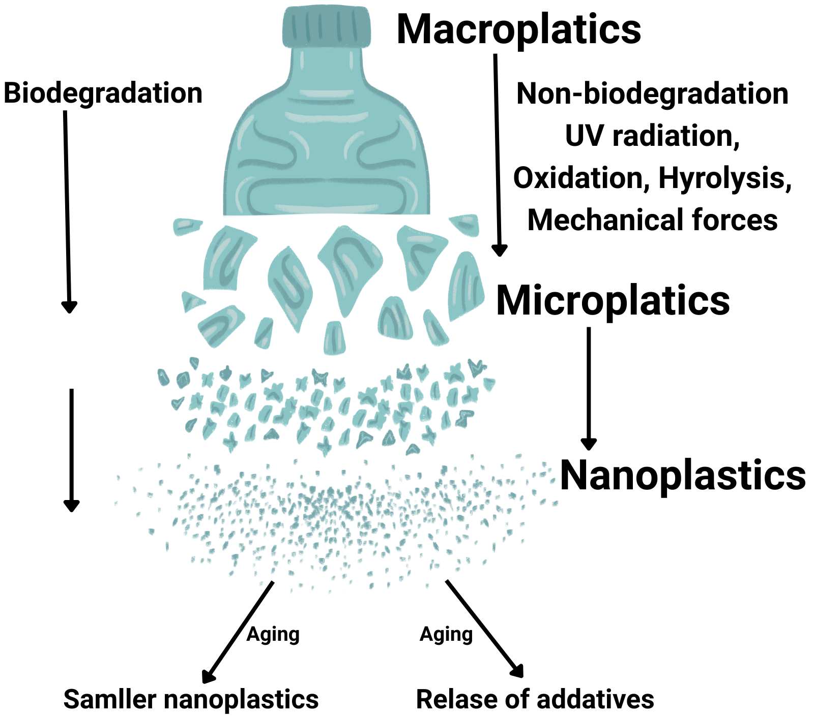
Microplastics?
Where are they found?
What are their impacts?
Oceans
Soil
Glaciers
Humas
COMPOST
Plant nutrient uptake ¹
Human/animal cell oxidative stress
Inflammation ³

Slide 3
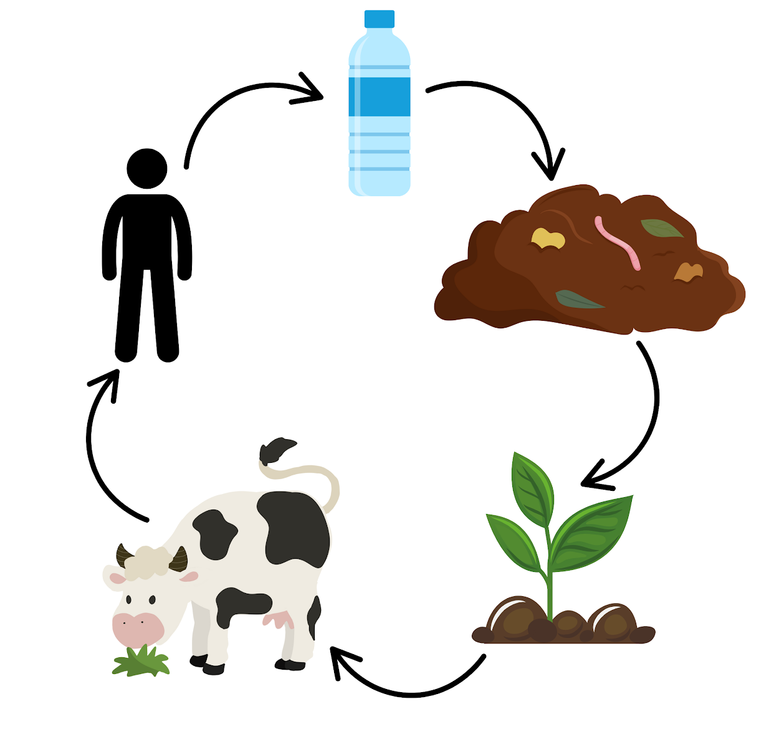
Why it is important?
Compost has many agricultural and environmental benefits
Compost impacts many ecological and biological system
  MP leach into soil → plants → animals → humans ²
Emilianting plastic contamination at a very crucial and controllable point in the natural environmental recycling processes

Slide 4
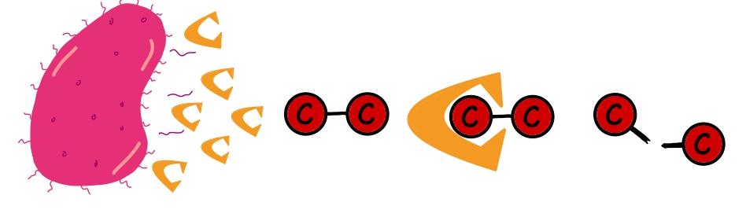
Compost
Contains microplastics but also other microscopic things that are very useful, which are BACTERIA
Compost is diverse in many bacterial species
Some bacteria contain genes that code for enzymes that can break the strong molecular bonds holding plastic compounds together ⁴
  Can break them into smaller molecules that can be metabolized by the bacteria

Slide 5
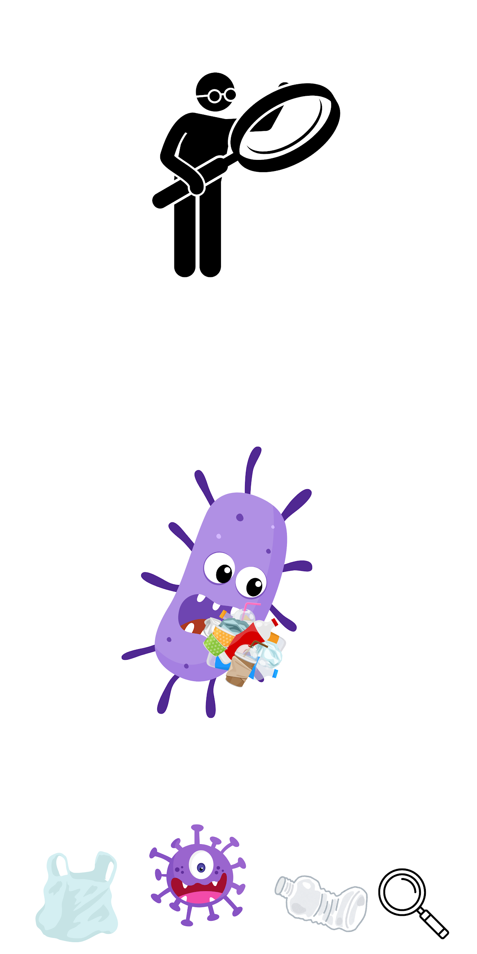
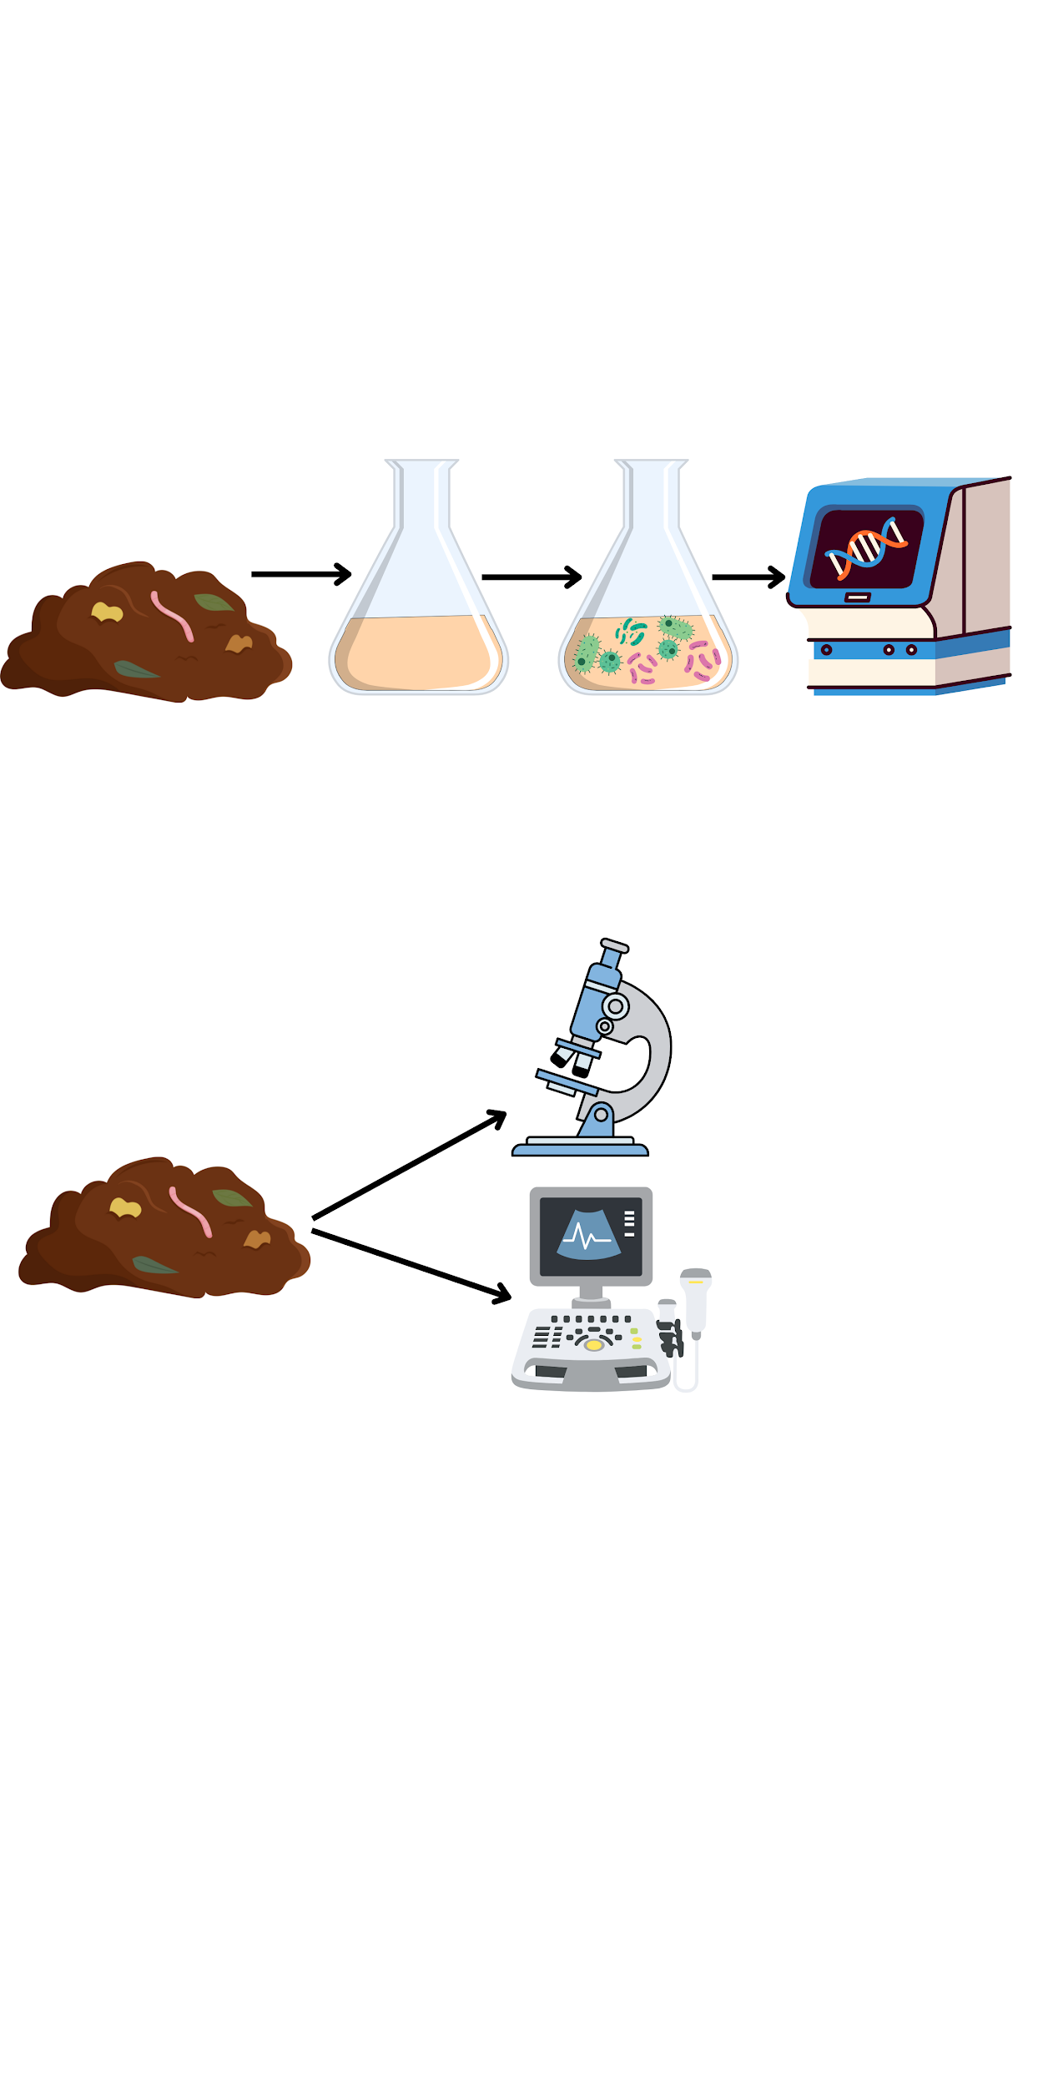
Project Goals
Identify in any bacteria already present in the compost that can degrade plastics
Detect microplastics in Kamloops compost

Slide 6
Detection of microplastics methodology
Microscopy and Spectroscopy Techniques
Fluorescent microscopy
Visualize plastics under the microscope
UV-Vis spectroscopy
Wavelength and absorbance peaks
Match peaks of plastic to compost

Slide 7
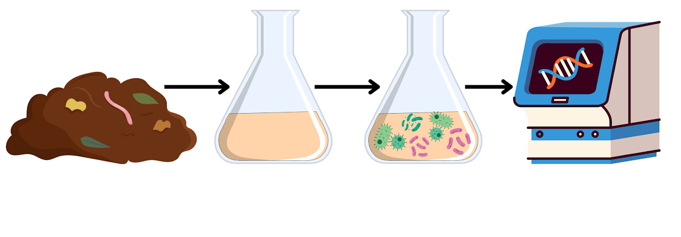
2. Bacterial microplastic degradation methodology
Multiple collection times as the compost matures
Grow in enriched media with plastic as its only Carbon source
16S rRNA sequencing (solid compost/liquid culture)

Slide 8
References
https://iopscience.iop.org/article/10.1088/1748-9326/ac652d/meta
https://www.sciencedirect.com/science/article/pii/S0147651324005025
https://pmc.ncbi.nlm.nih.gov/articles/PMC7920297/
https://pmc.ncbi.nlm.nih.gov/articles/PMC10386651/

