Slide 1

Why my project is important?
By: Emma Trotta

Slide 2
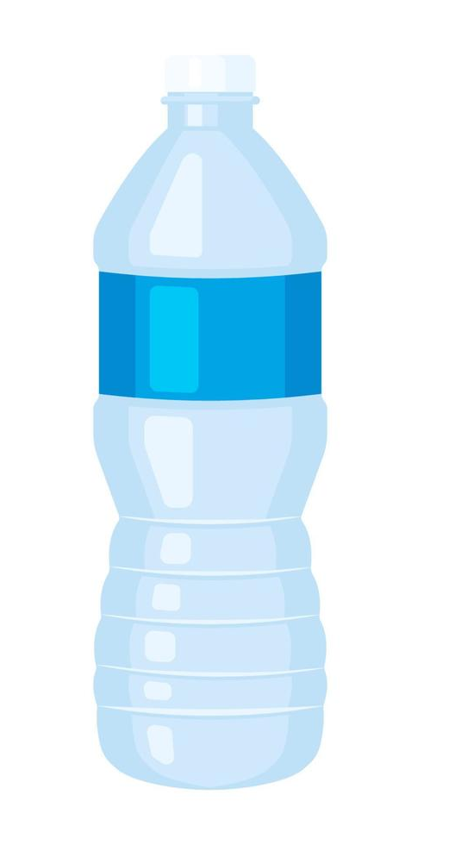
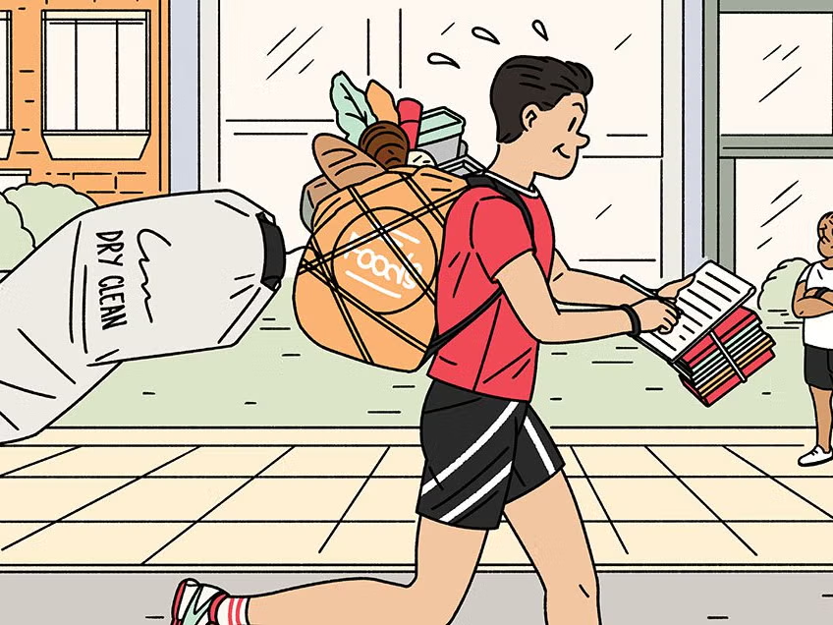
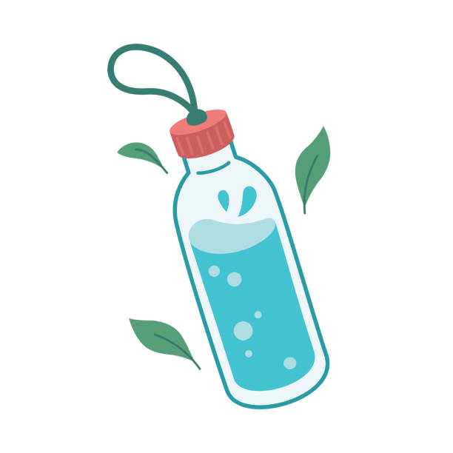
Picture this…

Slide 3
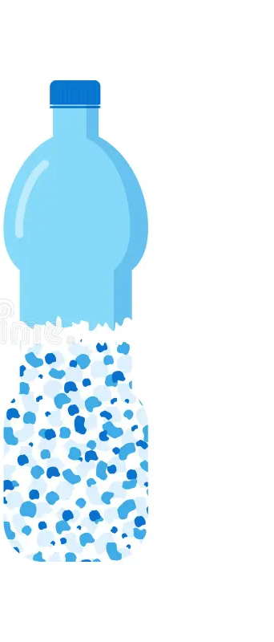
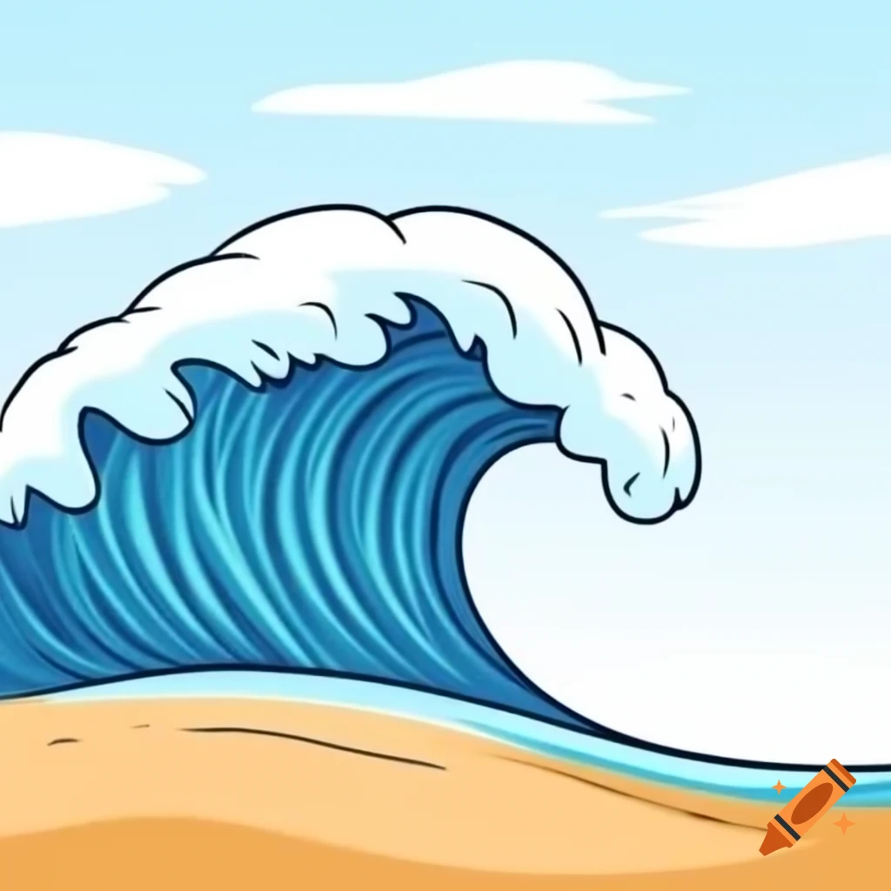
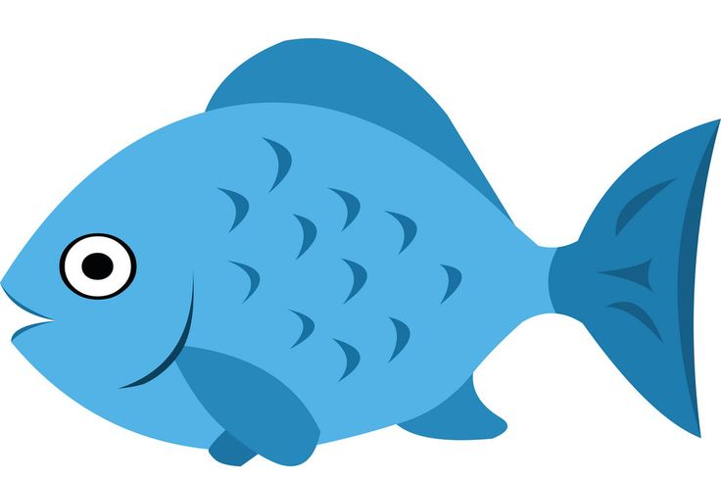

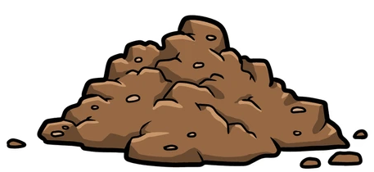
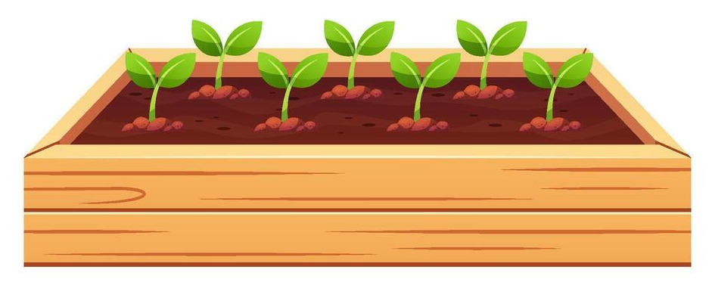
Microplastics
<5mm

Slide 4
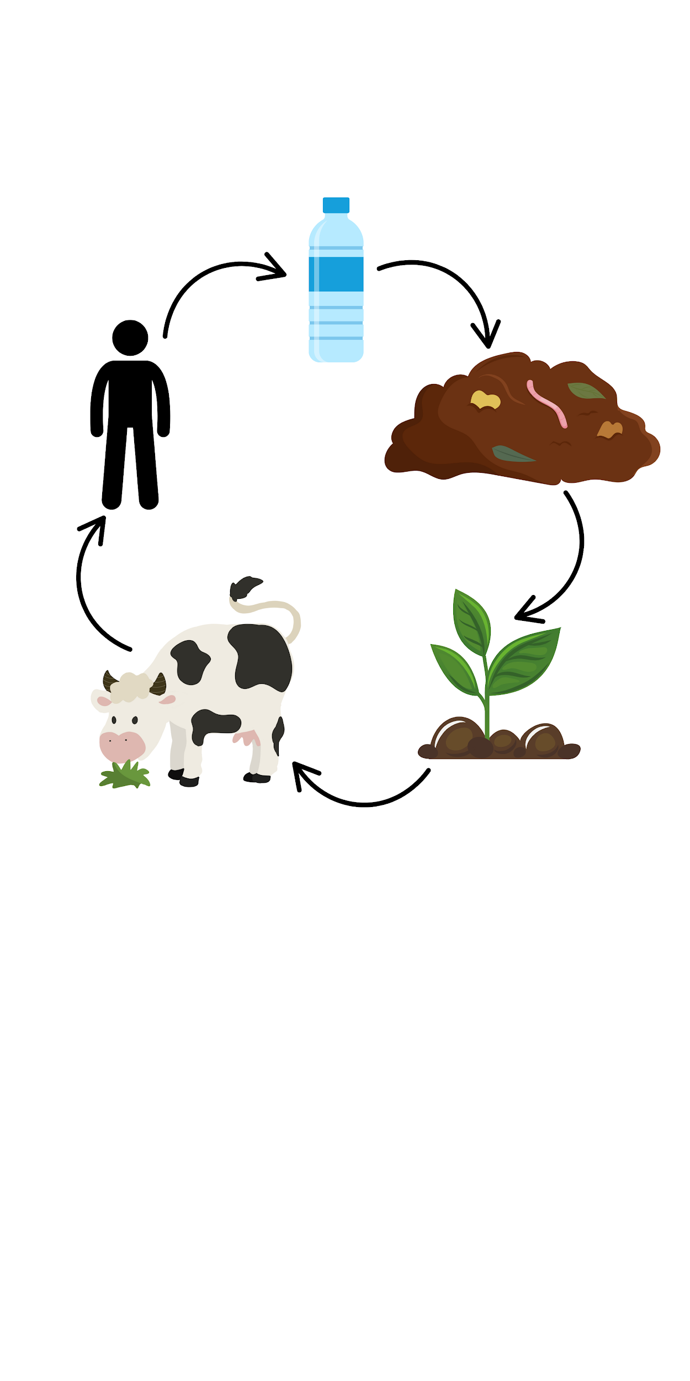
Oxidative stress
Inflammation
Digestive issues
Heat attack/Stroke
Mitigate plastic contamination in compost

Slide 5
Plastic Crisis
400 tons of plastic are made every year
Less than 10% gets recycled [1]
Contamination in terrestrial environments are 4-23 times more than in the ocean [2]
Solutions
Bacteria
Enzymes break strong C-C bonds of plastics
CO₂ and H₂O end products

Slide 6
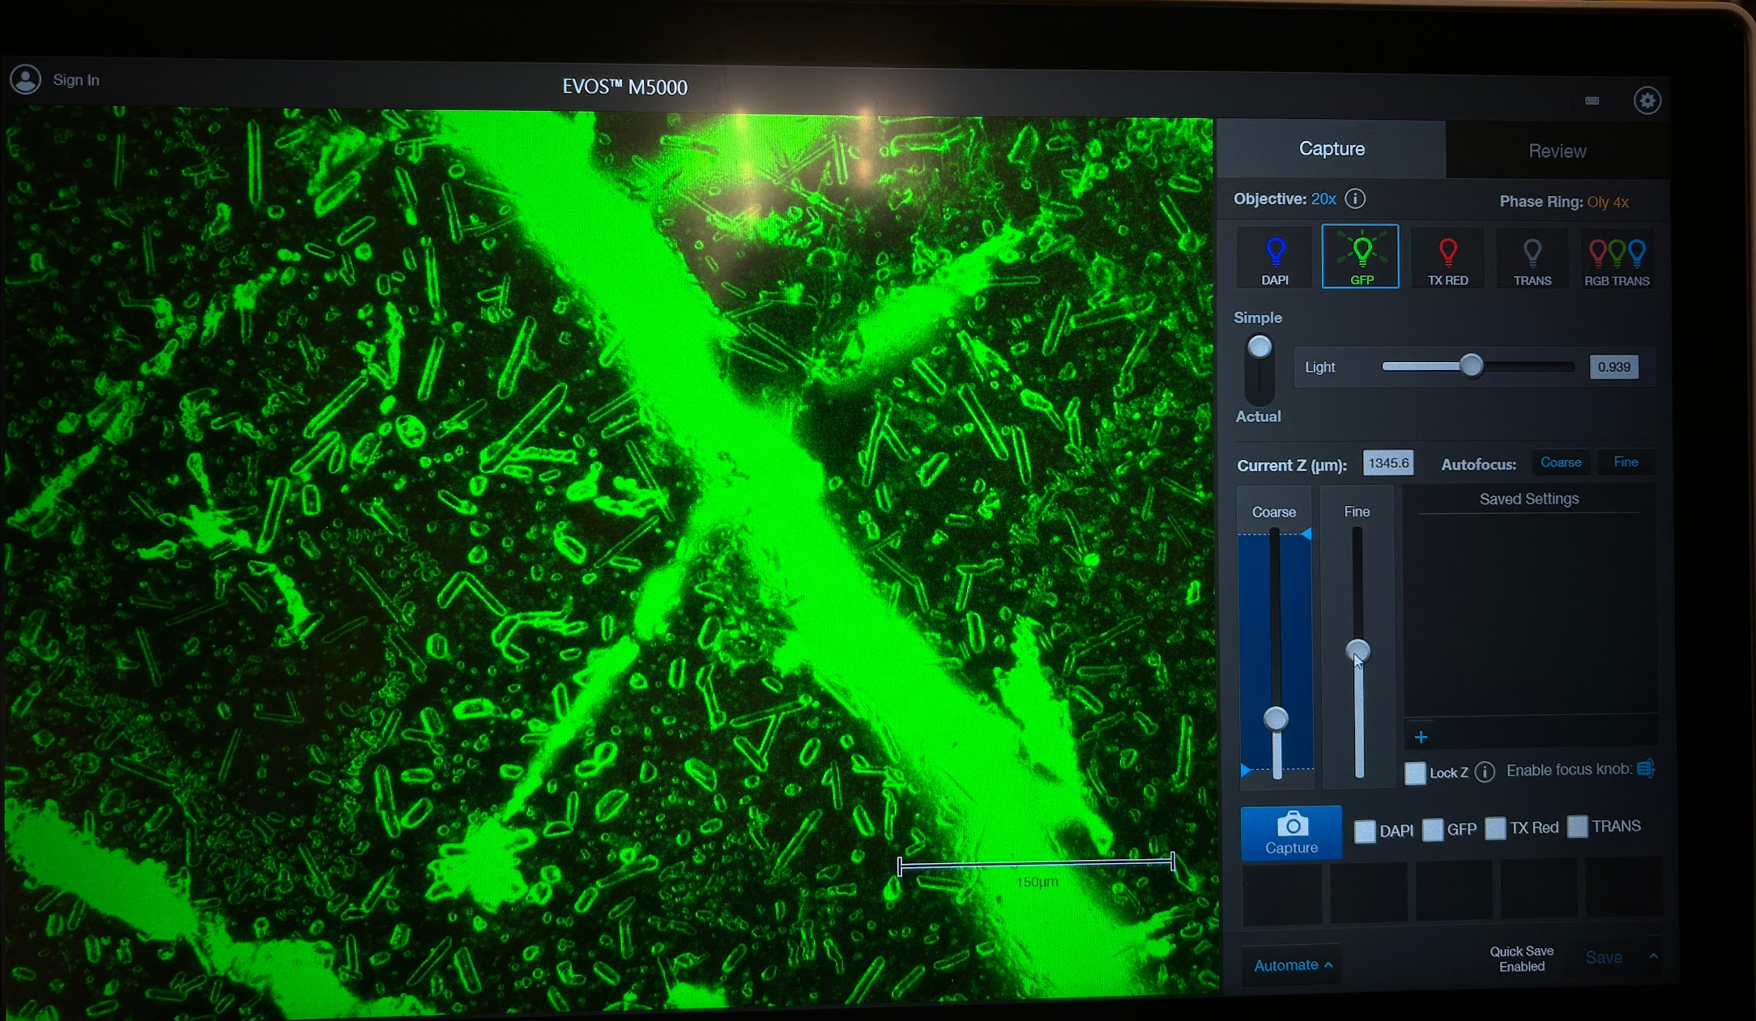
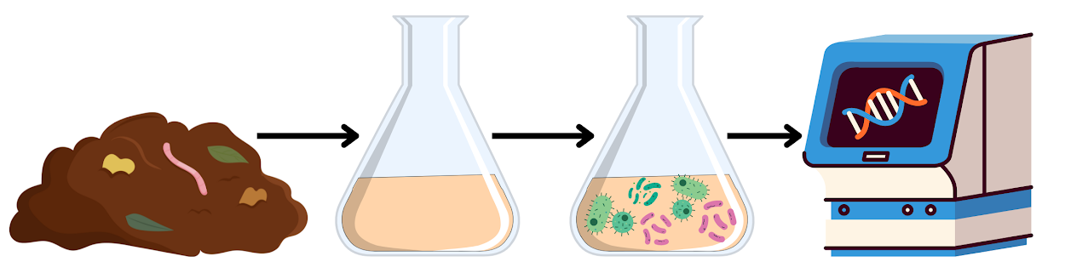
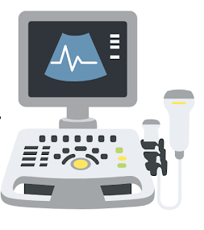
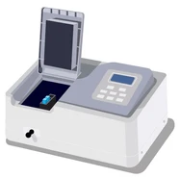
Steps
Identification
Mitigation
Fluorescent microscopy
UV-Vis
Raman

Slide 7
References
United Nations. 2025. World Environment Day | United Nations. United Nations. https://www.un.org/pl/node/71013.
Horton AA, Walton A, Spurgeon DJ, Lahive E, Svendsen C. 2017. Microplastics in freshwater and terrestrial environments: Evaluating the current understanding to identify the knowledge gaps and future research priorities. Science of The Total Environment. 586(586):127–141. https://doi.org/10.1016/j.scitotenv.2017.01.190
Yee MS-L, Hii L-W, Looi CK, Lim W-M, Wong S-F, Kok Y-Y, Tan B-K, Wong C-Y, Leong C-O. 2021. Impact of Microplastics and Nanoplastics on Human Health. Nanomaterials. 11(2):496. doi:https://doi.org/10.3390/nano11020496. https://www.mdpi.com/2079-4991/11/2/496. ‌

Slide 8
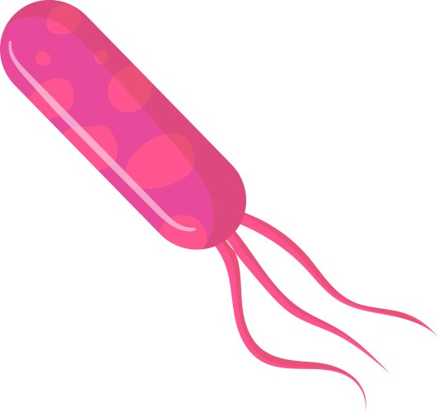
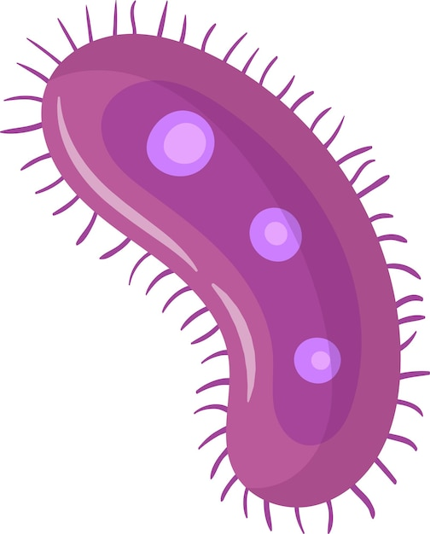
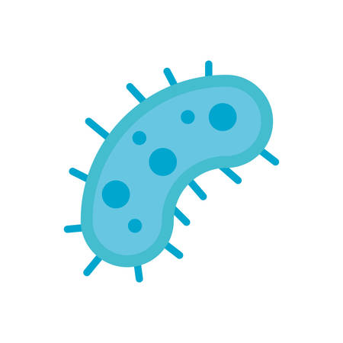
Thank You
Any Question?

